Slide 1

Pizza Sales Project
Enhancing Product Sales Strategy

Slide 2
Business Objectives Objective:
To analyze pizza sales data for operational, marketing, and product optimization using key metrics and trends across different levels of complexity.
Goals:
Understand customer preferences
Identify revenue drivers
Track performance over time
Support decision-making with data

Slide 3

Project Description
This project aims to uncover actionable insights from pizza sales data through multi-level analytical approaches. By leveraging SQL queries on key datasets, I examined order volumes, product preferences, revenue distribution, and sales patterns over time. Our analysis begins with basic sales performance metrics and scales up to more advanced insights such as cumulative revenue trends and category-wise revenue contributions. These insights support strategic decision-making in areas like marketing, operations, and product development. The project empowers stakeholders with clear, data-backed visibility into what drives sales and where growth opportunities lie.

Slide 4
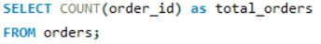
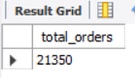

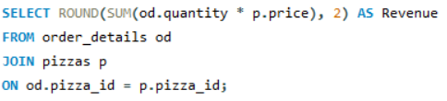
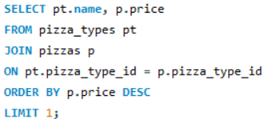
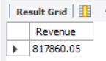
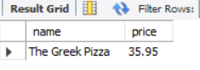
:- Retrieve the total number of orders placed.
:- Calculate the total revenue generated from pizza sales.
:- Identify the highest-priced pizza.

Slide 5
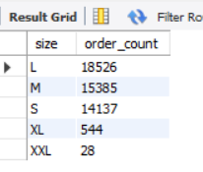
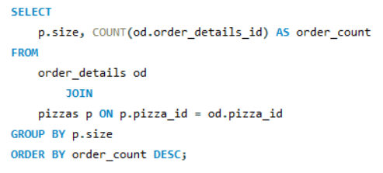
:- Identify the most common pizza size ordered.

Slide 6
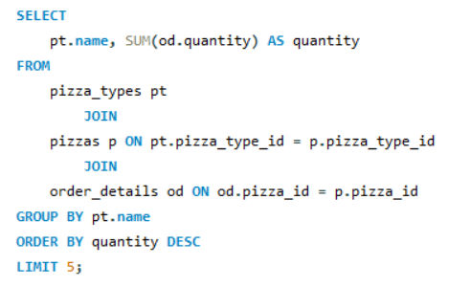
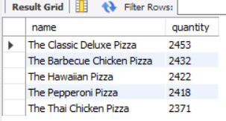
List the top 5 most ordered pizza types along with their quantities.

Slide 7
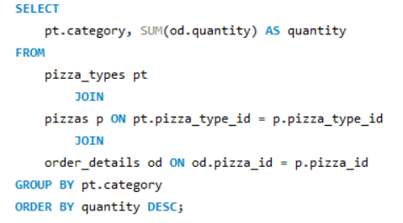
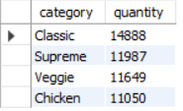
Join the necessary tables to find the total quantity of each pizza category ordered.

Slide 8
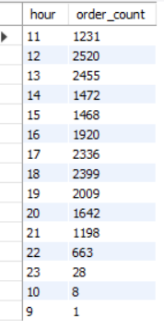
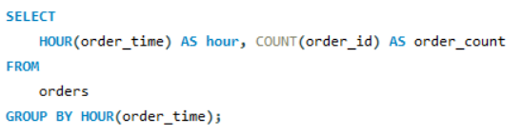
Determine the distribution of orders by hour of the day.

Slide 9
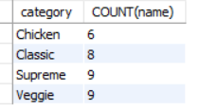
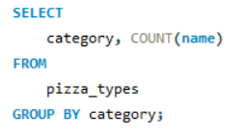
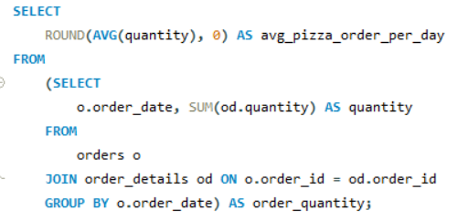
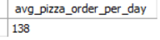
Join relevant tables to find the category-wise distribution of pizzas.
Group the orders by date and calculate the average number of pizzas ordered per day.

Slide 10
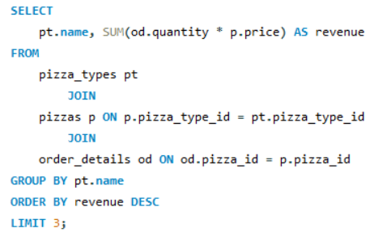
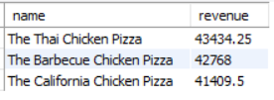
Determine the top 3 most ordered pizza types based on revenue.

Slide 11
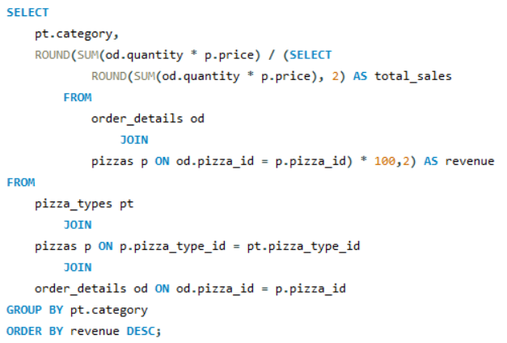
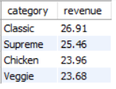
Calculate the percentage contribution of each pizza type to total revenue.

Slide 12
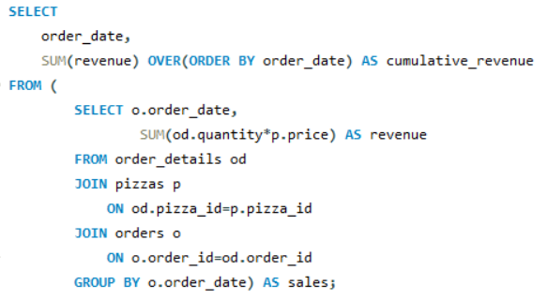
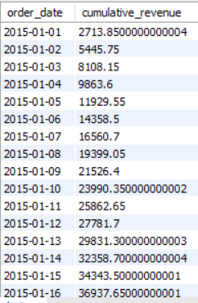
Analyze the cumulative revenue generated over time.

Slide 13
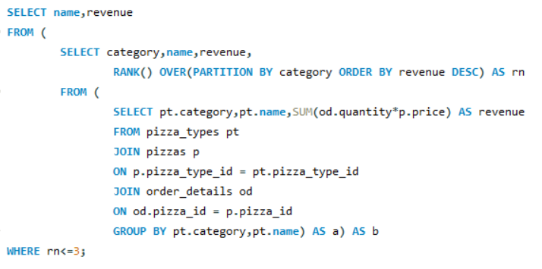
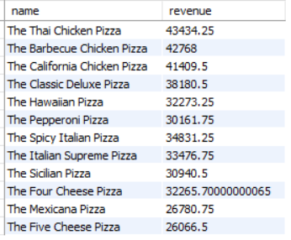
Determine the top 3 most ordered pizza types based on revenue for each pizza category.

Slide 14


Project Outcomes
Business Outcomes What We Achieve:
Tools & Methods
SQL for Data Extraction & Joins
Group By, Aggregate Functions, and Joins
Time-Series Analysis for Cumulative Revenue
Ranking and Window Functions for Top Performers
Clear visibility of sales dynamics
Better marketing around high-performers
Optimized operations during peak times
Enhanced strategic decision-making

Slide 15
Conclusion
By implementing a well-researched and innovative sales strategy, our goal is not only to boost immediate sales figures but also to establish a sustainable framework for continued growth and success.

Slide 16
Thank you

